Slide 1
Survival Analysis

Slide 2
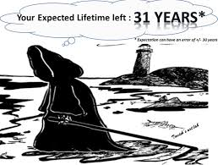

Slide 3
Survival Analysis
Set of statistical approaches used to determine the time it takes for an event of interest to occur.
Importance :
1. Medical Field.
2. Predictive Maintenance in Mechanical Operations.
3. Actuaries.

Slide 4
Time to Event
Reflects the time until a participant has an event of interest (heart attack, death, etc.)

Slide 5
Types of Events:
1. Relapse
2. Progression
3. Death

Slide 6
Censoring
The event we are interested in does not occur:
1. Right
2. left
3. Interval

Slide 7
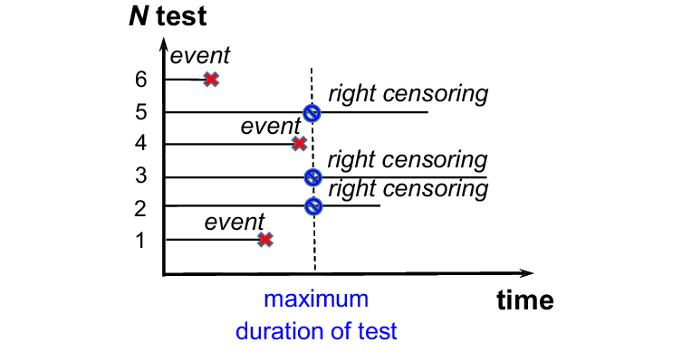
Most common type is Right censoring: This can occur when a participant drops out before the study ends or when a participant is event free at the end of the observation period.

Slide 8
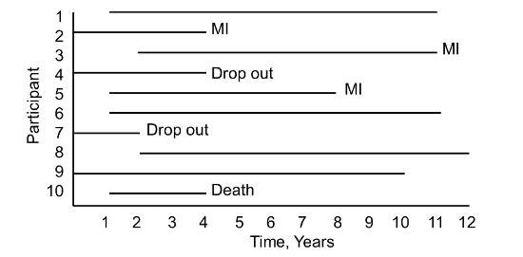
Censoring
If we choose not to include the censored data, then it is highly likely that our estimates would be highly biased and under-estimated.
The inclusion of censored data to calculate the estimates, makes the Survival Analysis very powerful.

Slide 9
Kaplan-Meier Estimate
Deal with incomplete observations.
The Kaplan-Meier curves and estimates of survival data have become a familiar way of dealing with differing survival times (times-to-event), especially when not all the subjects continue in the study.

Slide 10
Kaplan-Meier Estimate
In preparing Kaplan-Meier survival analysis, each subject is characterized by three variables:
1) Their serial time.
2) Their status at the end of their serial time (event occurrence or censored).
3) The study group they are in.

Slide 11
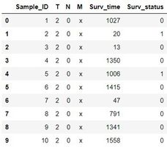
DATA

Slide 12
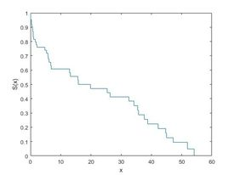
Kaplan-Meier Estimator
ecdf(y,'censoring',cens,'function','survivor');

Slide 13
THANK YOU!!

Slide 14
Kaplan-Meier Estimate
Since we don’t have the true survival curve of the population, thus we will estimate the survival curve from the data.
ni: the population at risk at time just prior to time ti
di: number of events occurred at time ti

